Slide 1
GOLF - How to improve
Victor Nicolausson

Slide 2
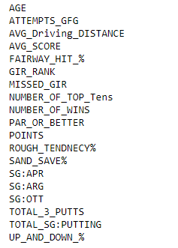
Dataset : PGA Tour 2017 full stats for all players
Clustering based on 19 different stats:

Slide 3
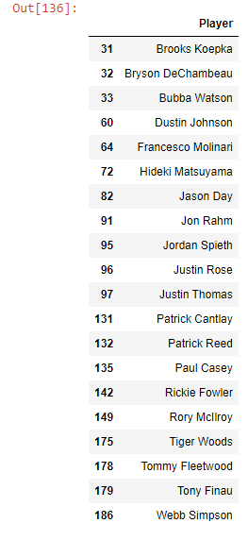
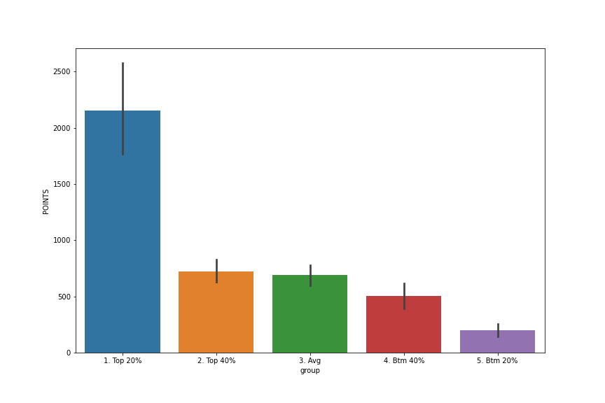
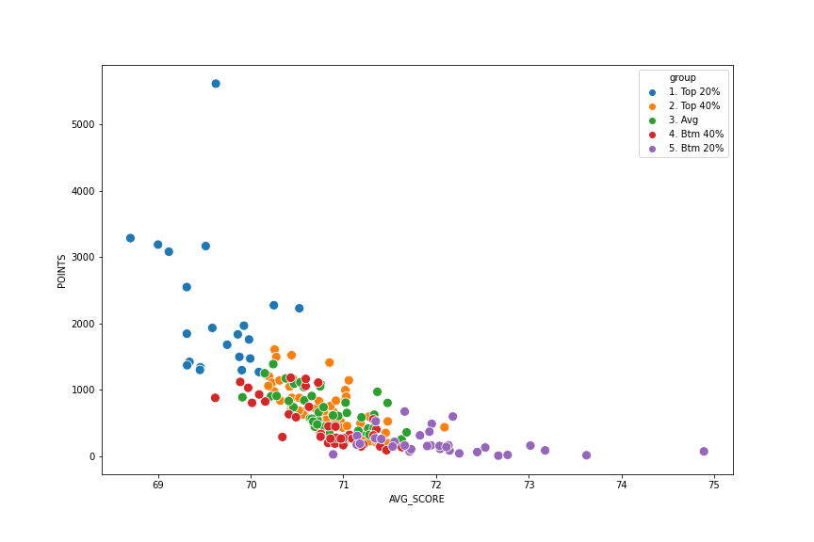
5 clusters

Slide 4
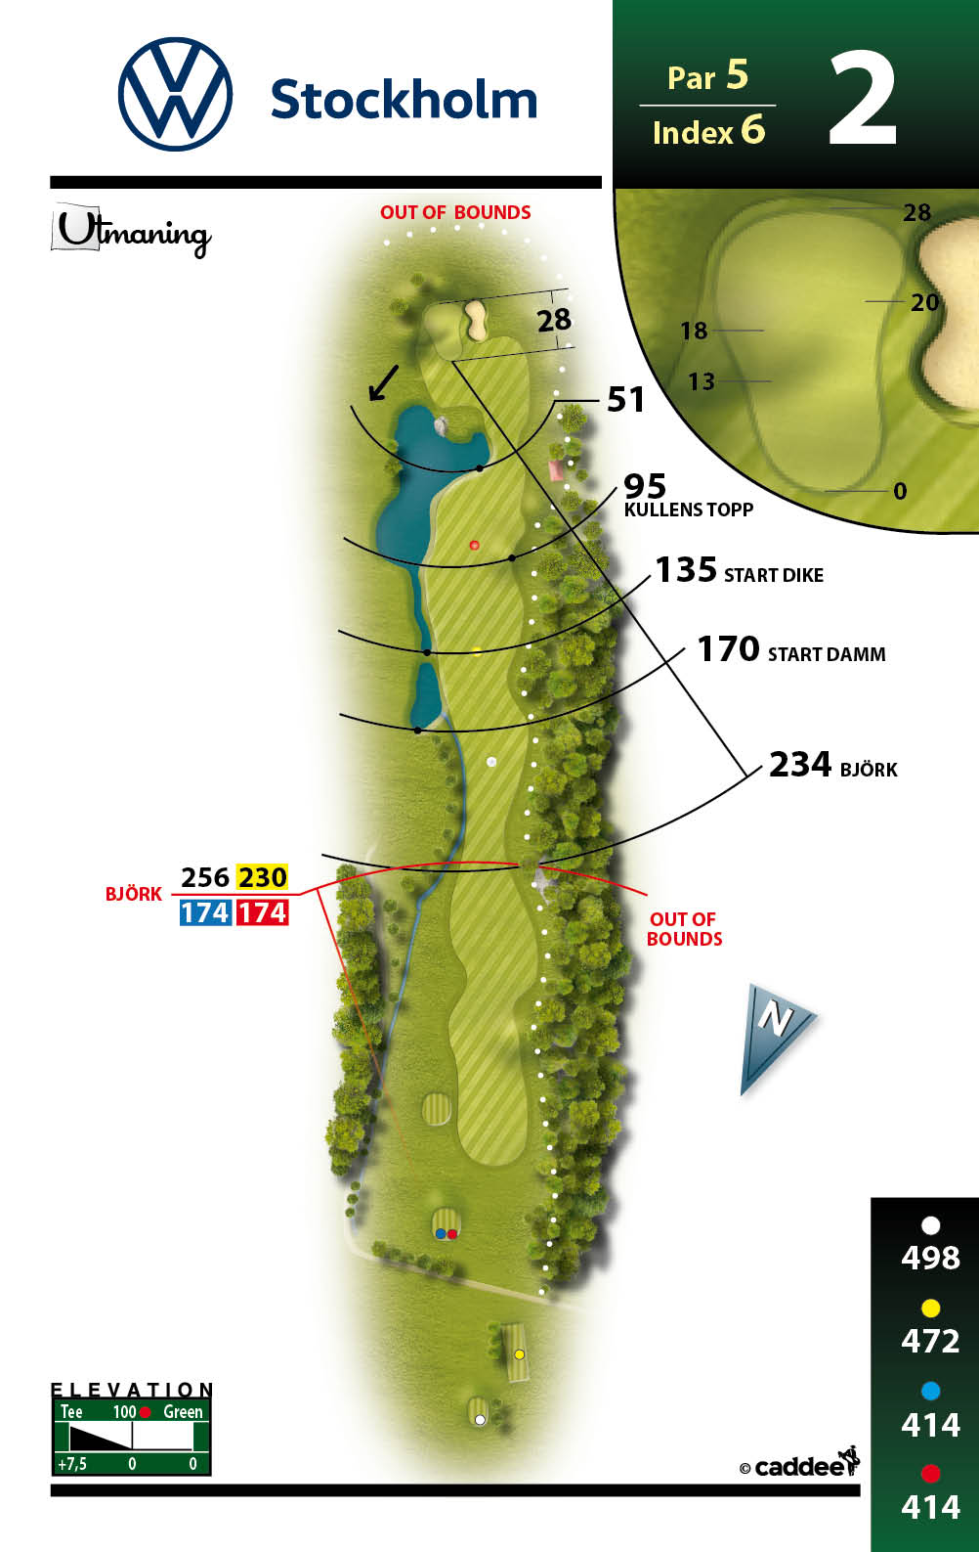
So, how should I play to advance?
Check the data!
In order to demonstrate we will “play” a hole, in
this case hole 2 of Gustavs home course.
Par 5, 498m from the back tee
Should reach green in 3 >= shots
All golf holes designed for 2 puts
Maximum desired score is 5

Slide 5
Tee shot.
What is most important?
Hit it long
Hit it straight
Both (ideal)

Slide 6
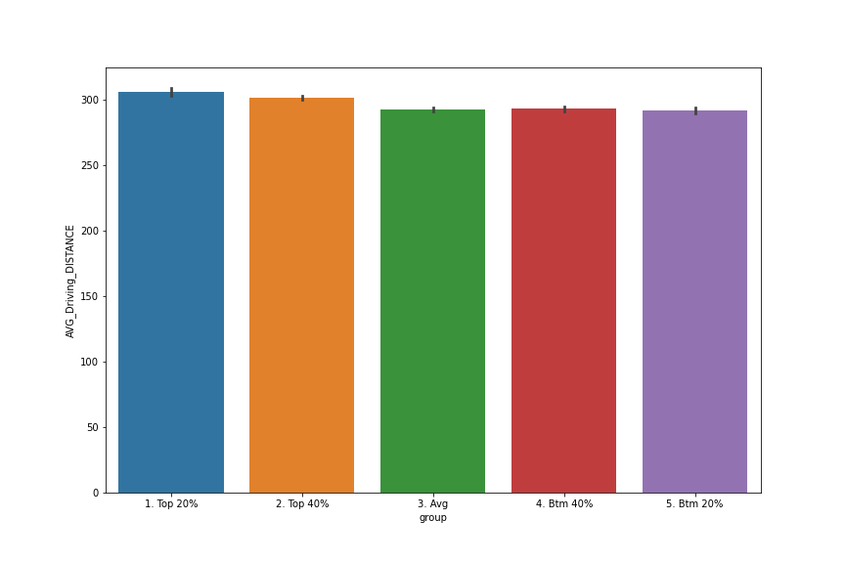
F’N BOMB IT

Slide 7
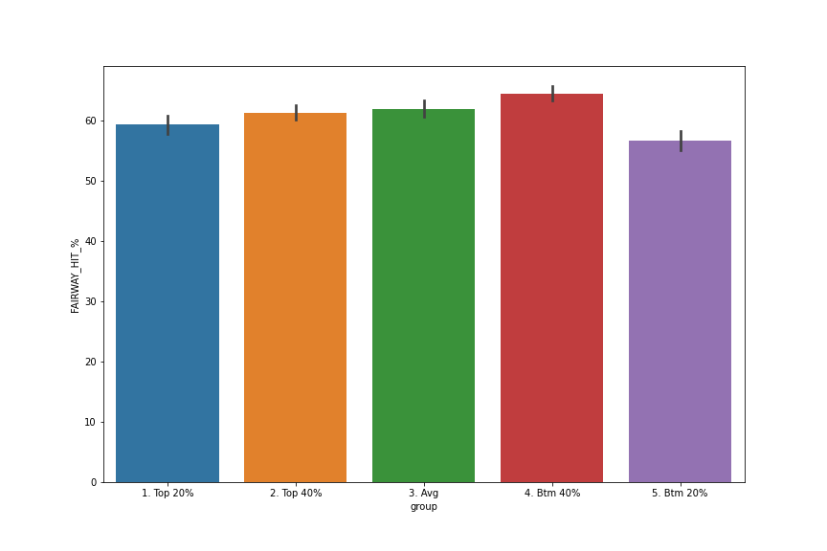
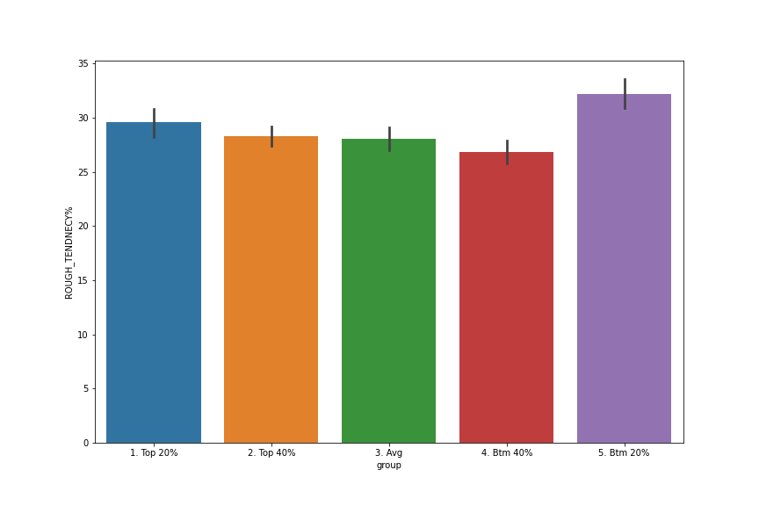
FAIRWAYS HIT %
ROUGH TENDENCY % (THICK GRASS)

Slide 8
2nd shot
You fucking bombed it, time for 2nd shot.
What to do? Go for the green, or lay up?
Getting on the green gains you 1 stroke
Laying up is “according to design”

Slide 9
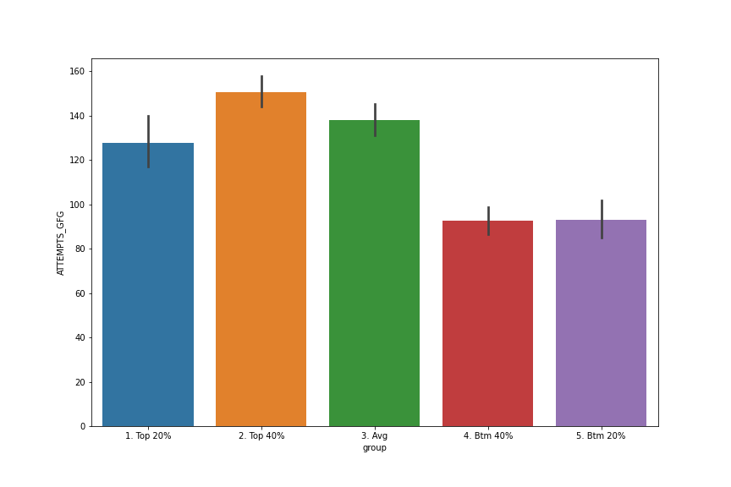
Play it safe

Slide 10
3rd shot
Now we have to go for it.
4 most likely outcomes:
Green (GIR)
Bunker
Rough
Short
How important is it that
we hit the green?

Slide 11

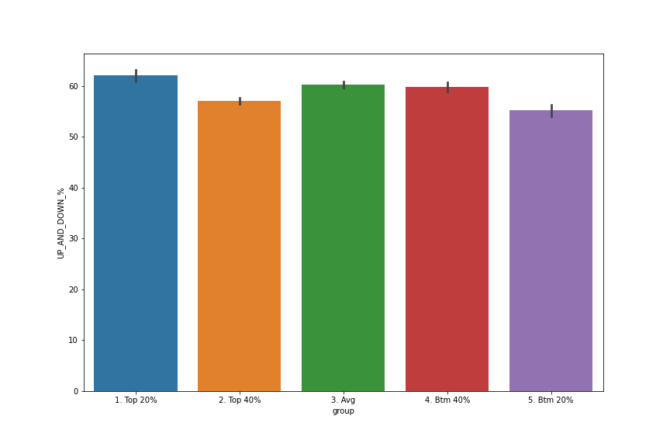
We missed! Up and down (saviour/clutch shot)

Slide 12
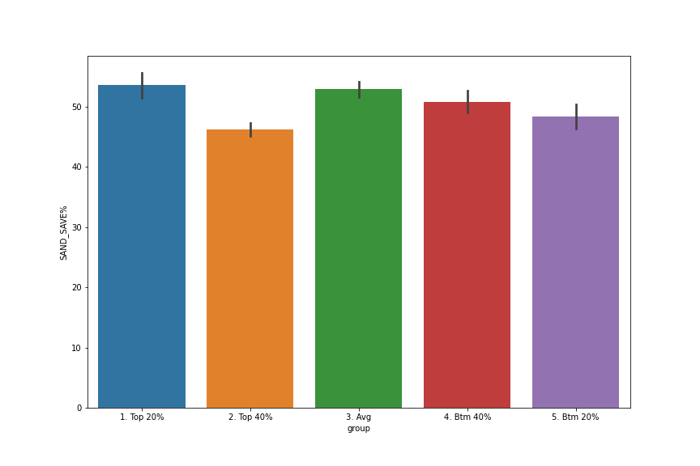
Sand saves % (saviour/clutch shot)

Slide 13
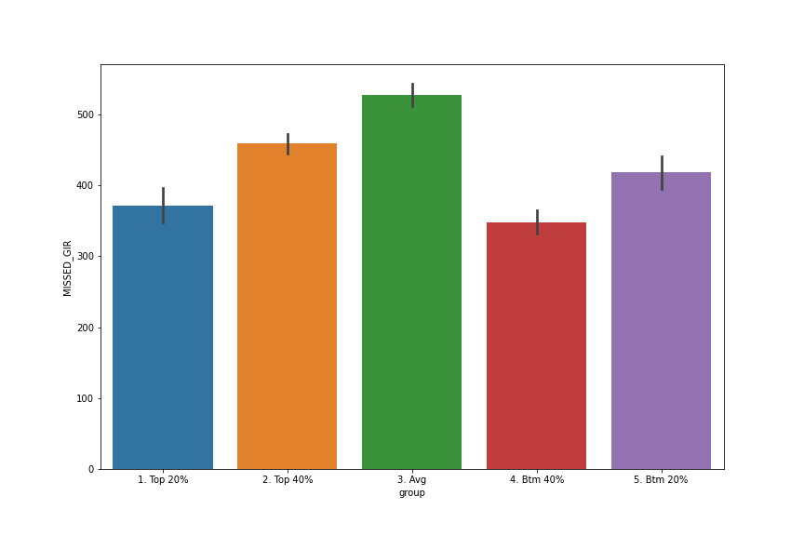
Missed GIR

Slide 14
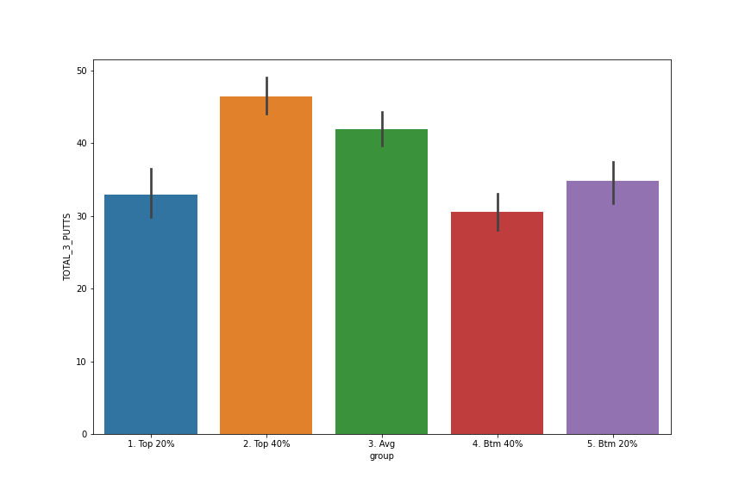


Drive for show, putt for dough
=

Slide 15
Conclusions, what to work on
BOMB IT OFF THE TEE
GET BETTER IN THE ROUGH (VERY IMPORTANT)
PLAY IT SAFE(ER)
GET IT ON THE GREEN (VERY IMPORTANT)
PUTT GOOD (REALLY IMPORTANT)

Slide 16
fin.

